Slide 1
Project Name: csRecruitZ
CSE 408: Presentation on Class Diagram and ERD
Team members:
Adrita Hossain Nakshi (1705019)
Samira Akter (1705028)
Simantika Bhattacharjee Dristi (1705029)

Slide 2
Use Cases
For jobseeker:
Search Jobs
Sort Jobs
Job recommendation
View job details and apply online
Follow employer
Shortlist jobs
View and edit personal information
Upload resume
Maintain professional identity
View notification
For employer:
View posted jobs
View applicant list
Create job post

Slide 3
Full Class Diagram

Slide 4
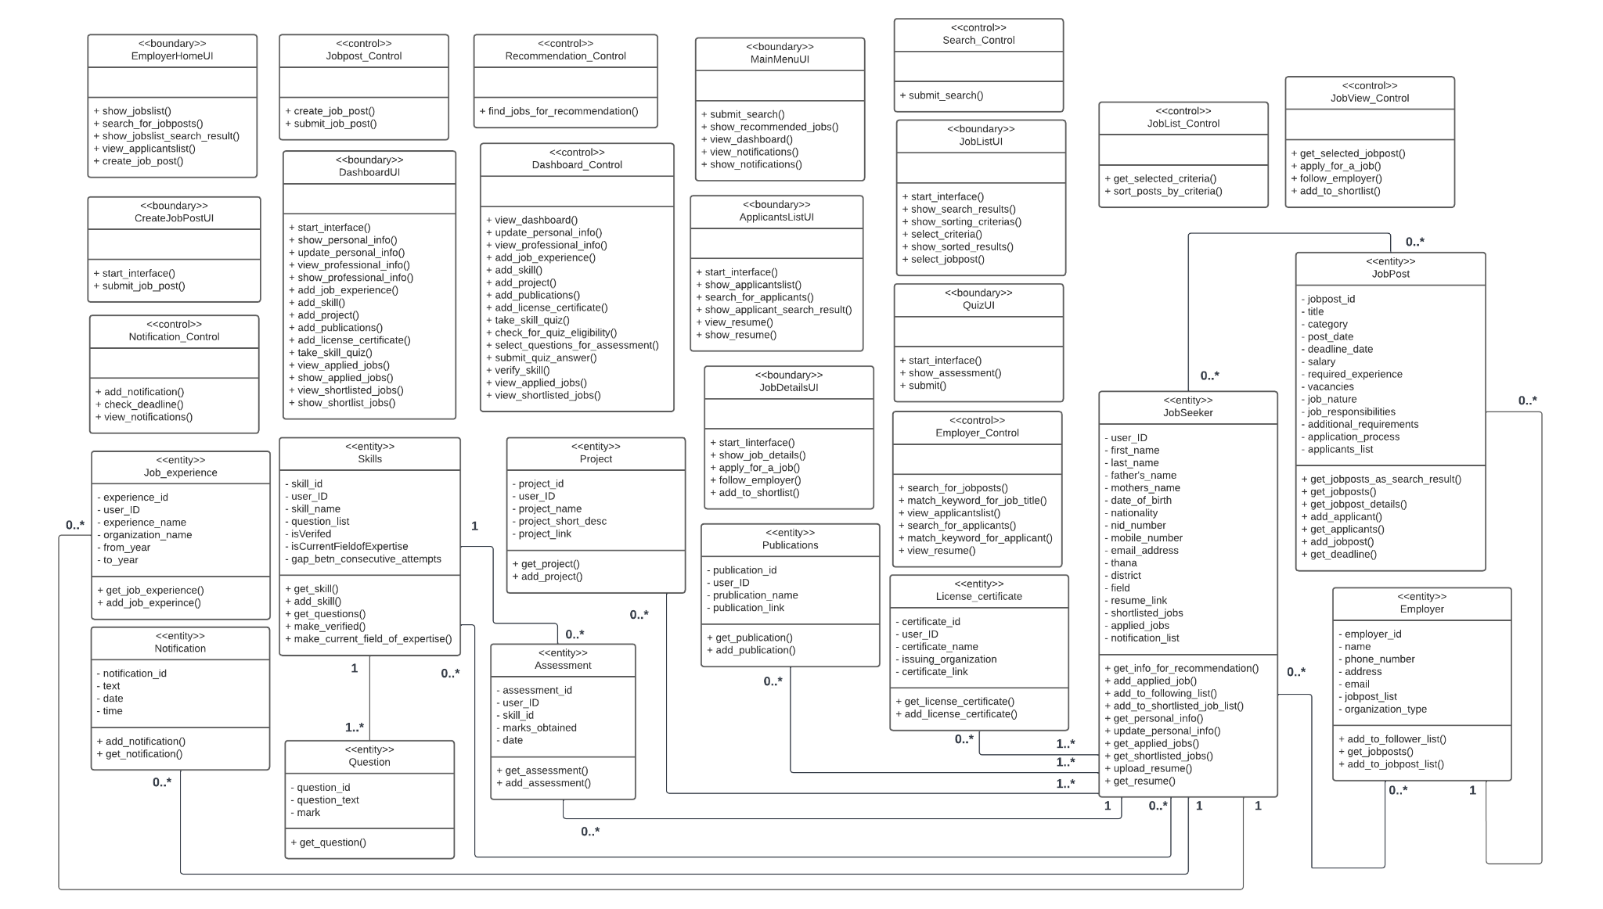

Slide 5
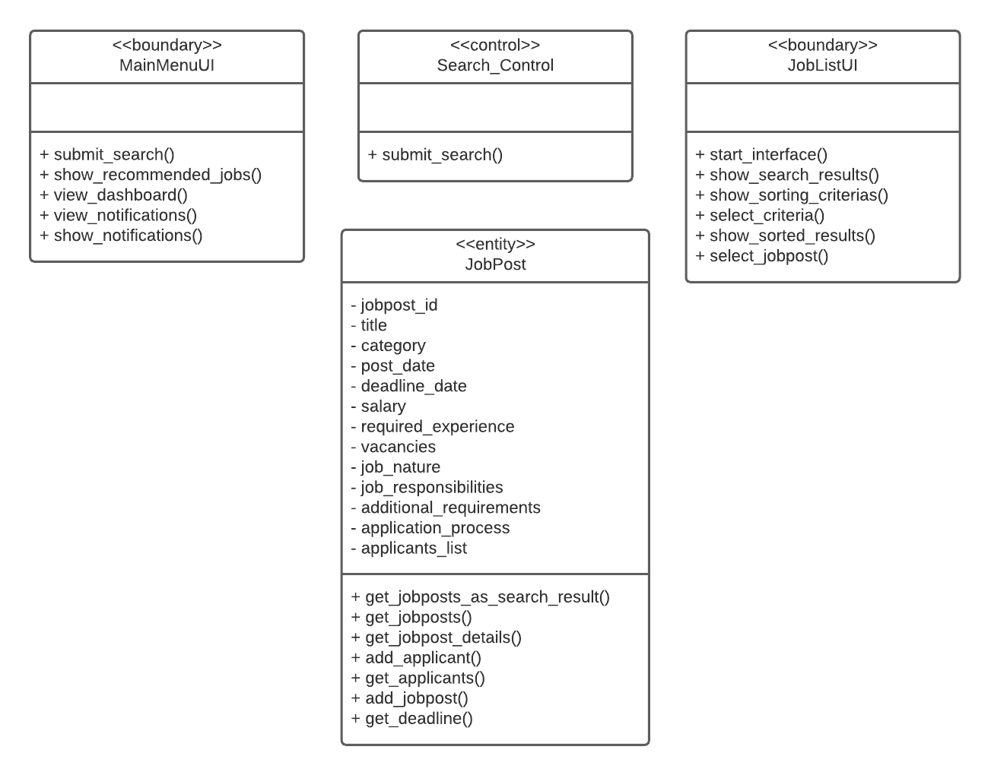
Search Jobs

Slide 6
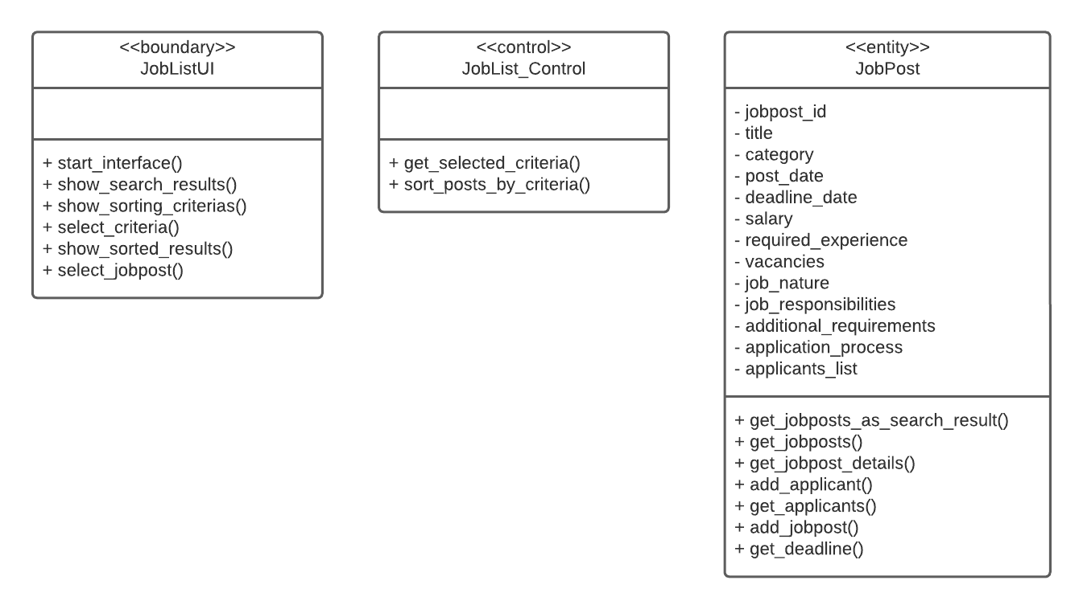
Sort Search Results

Slide 7
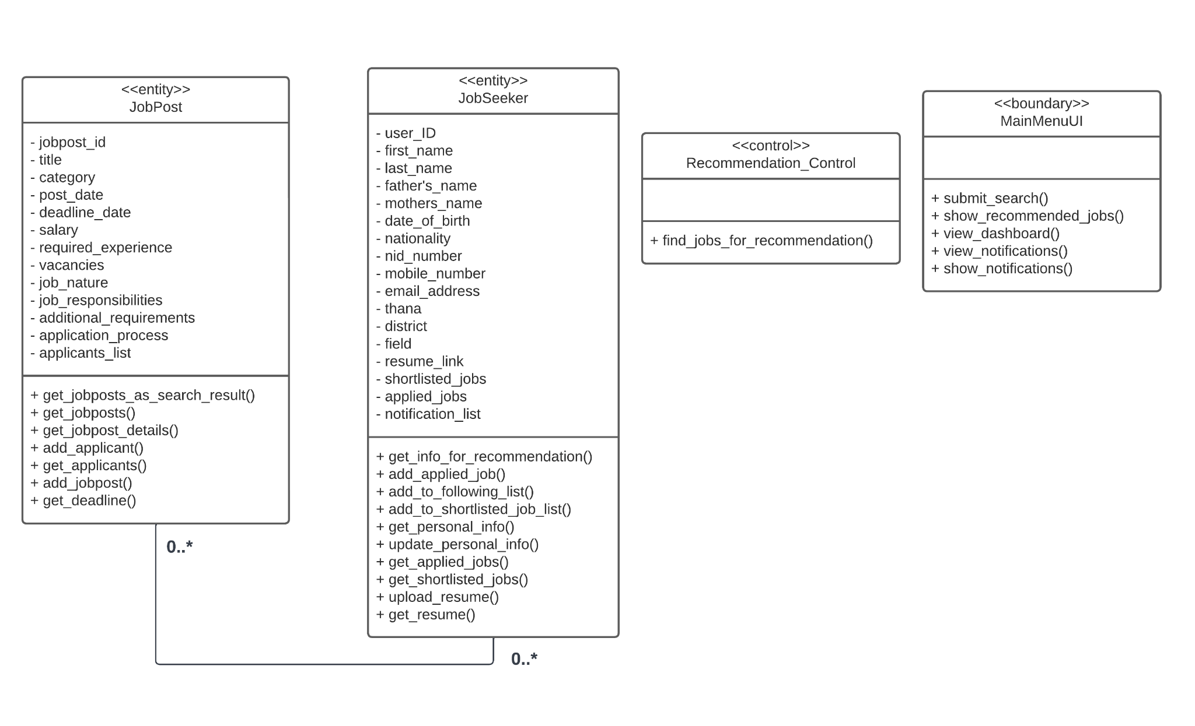
Recommendation

Slide 8
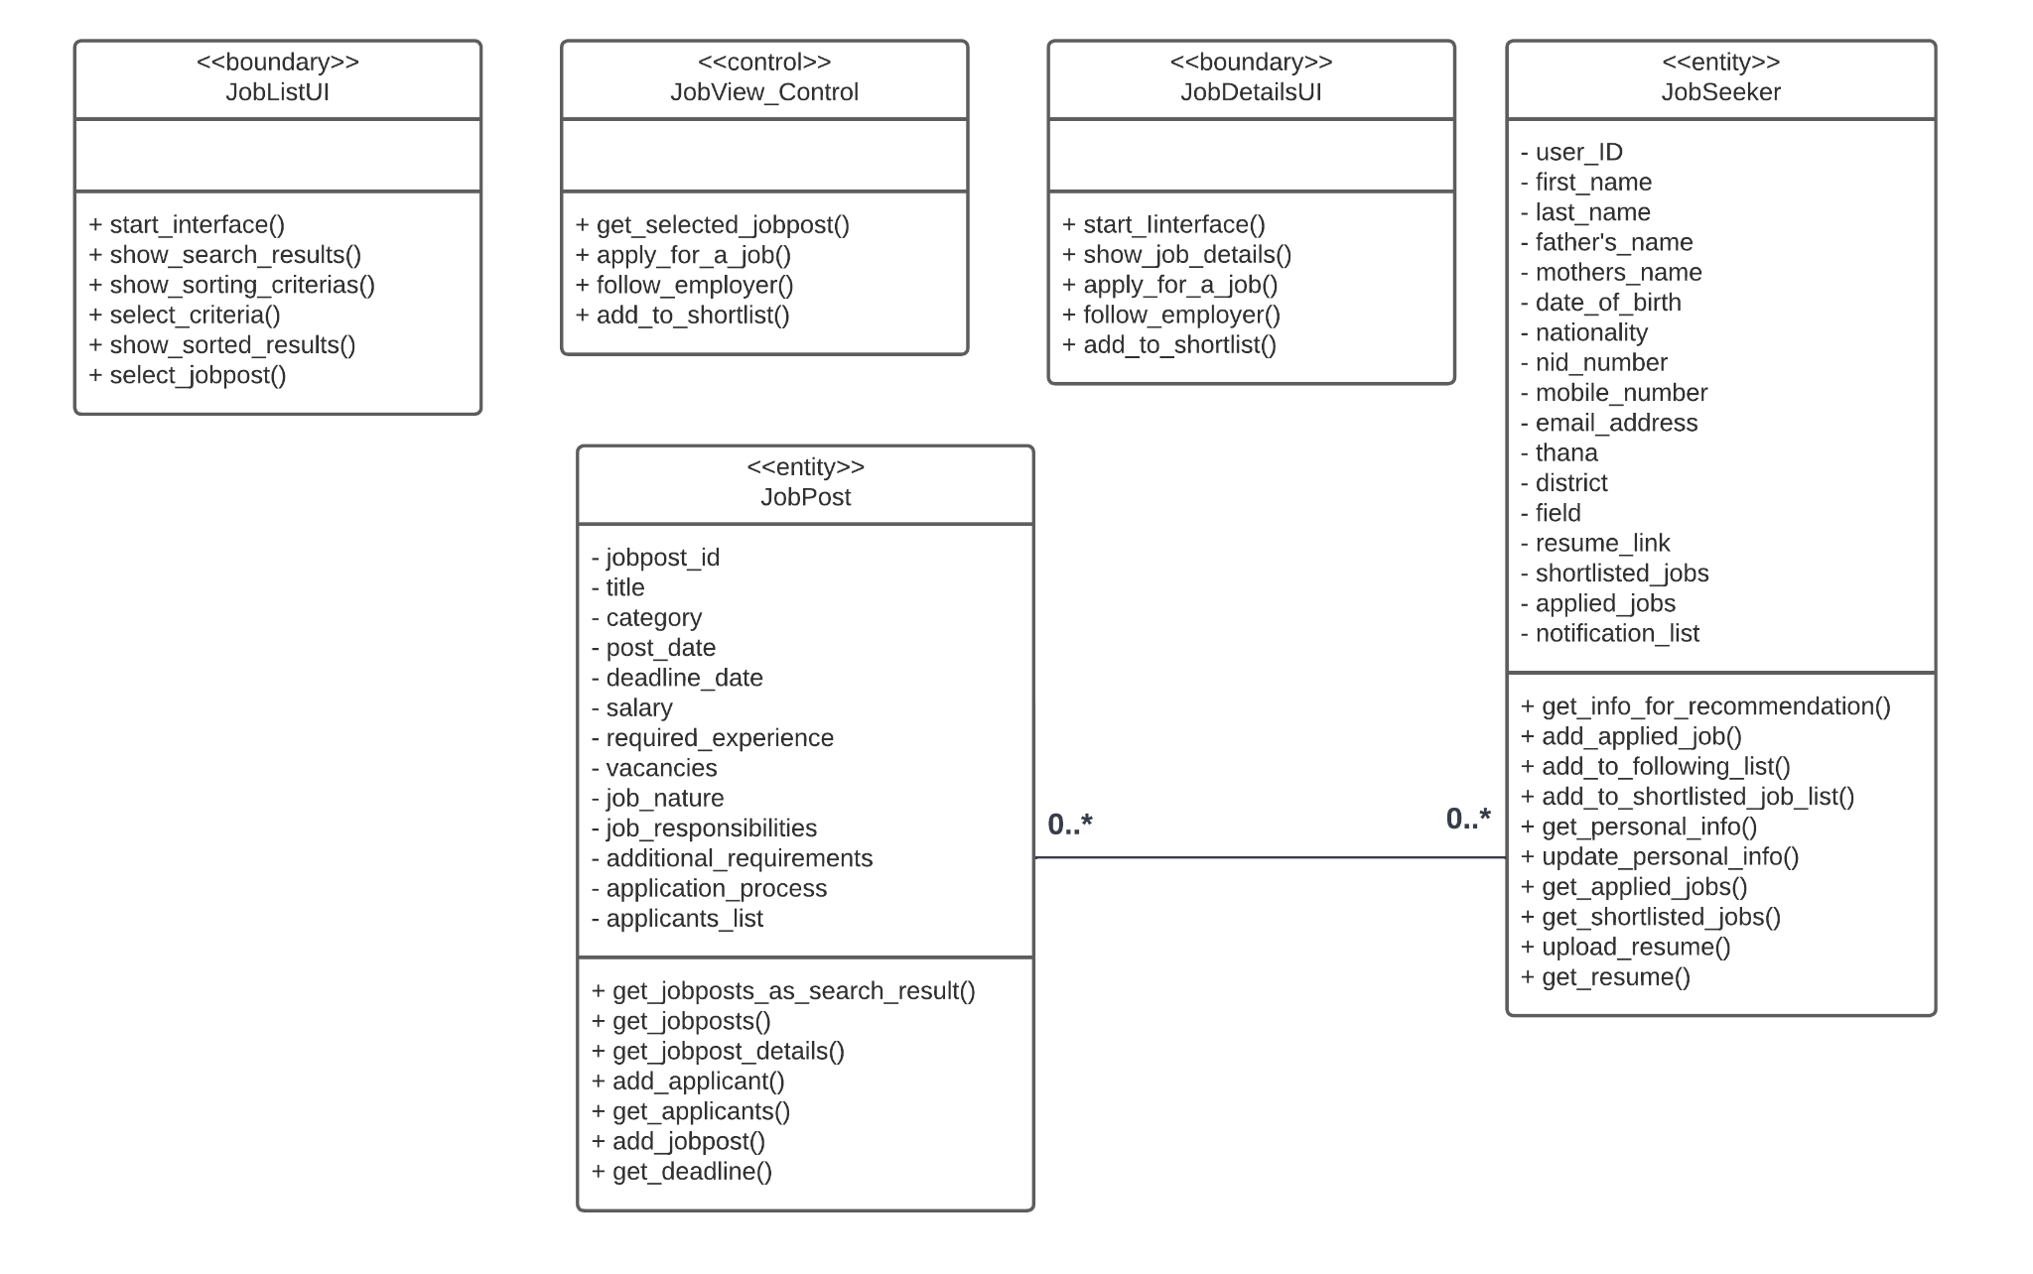
Job View and Application

Slide 9
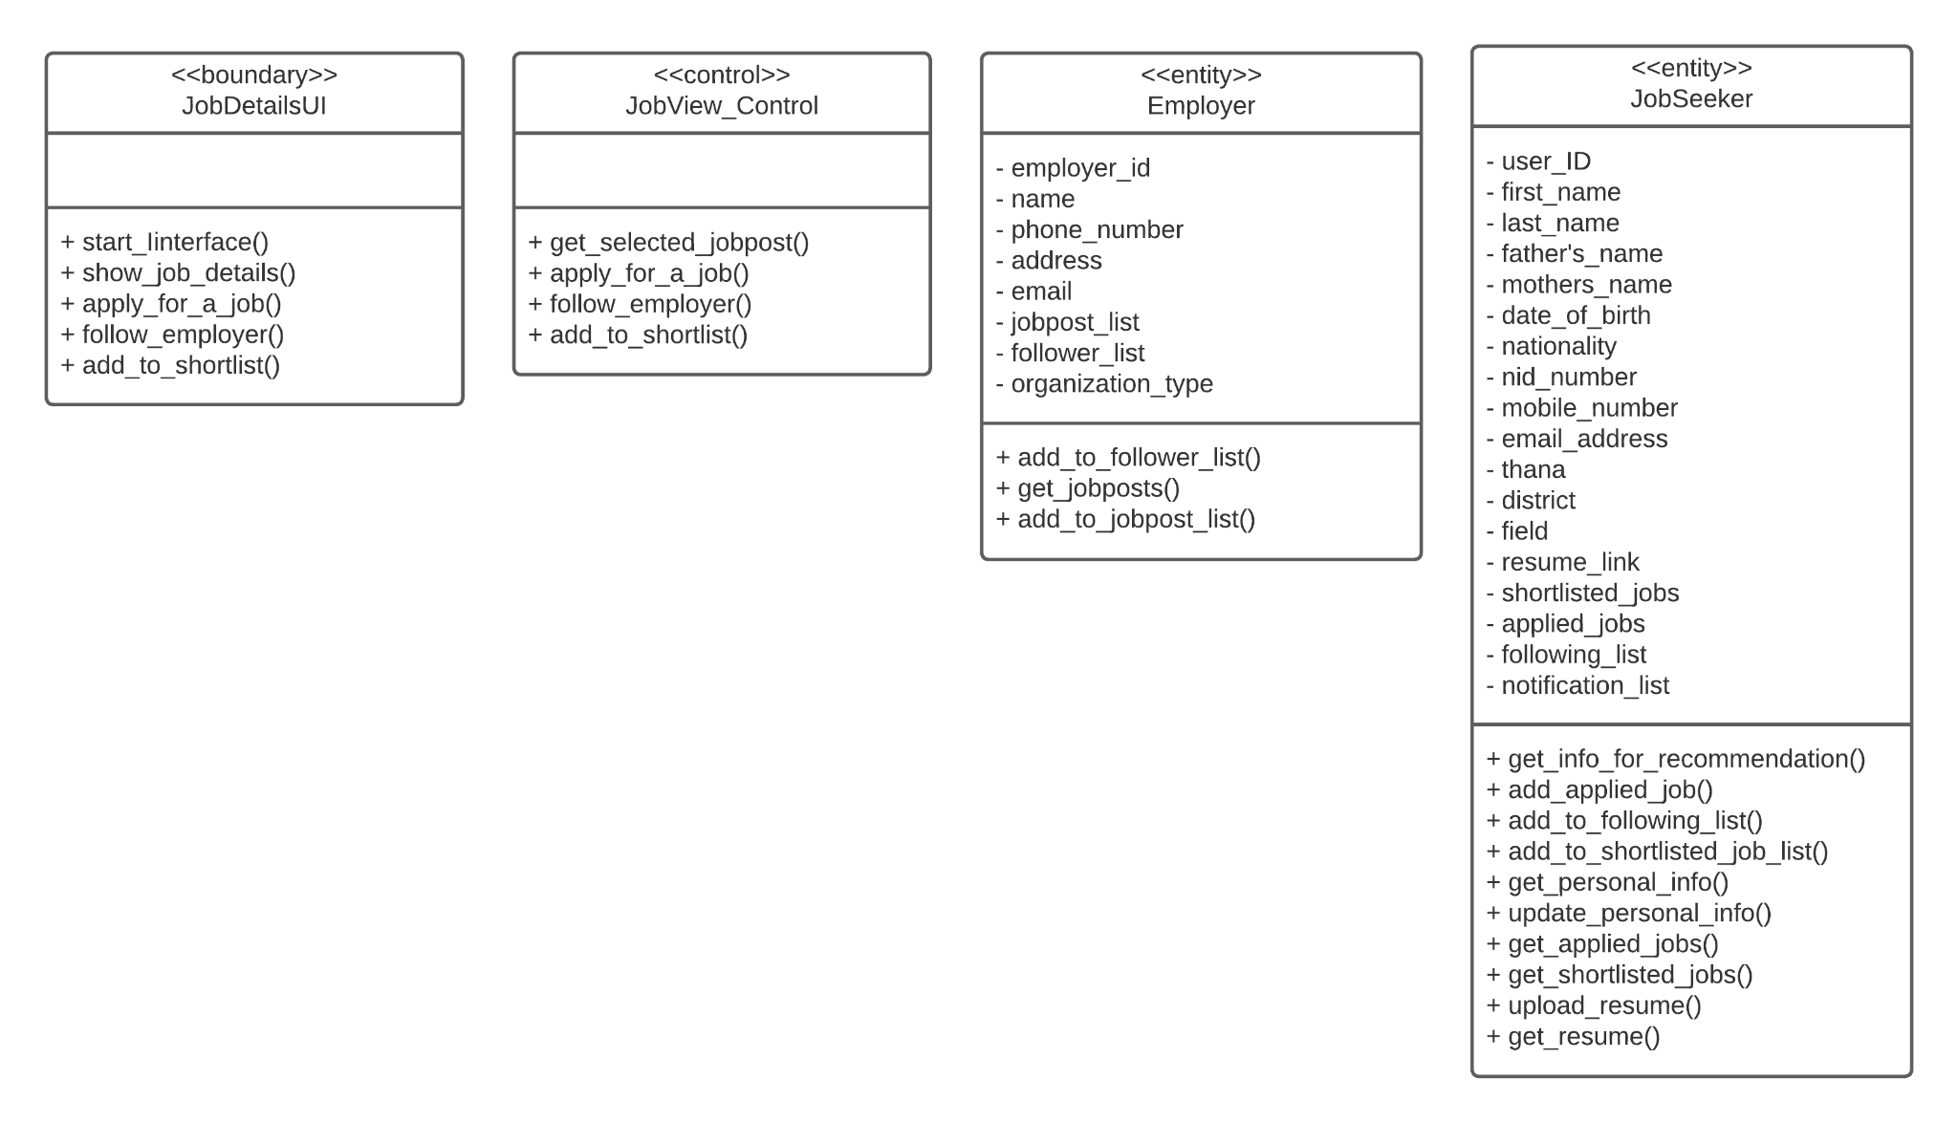
Follow Employer

Slide 10
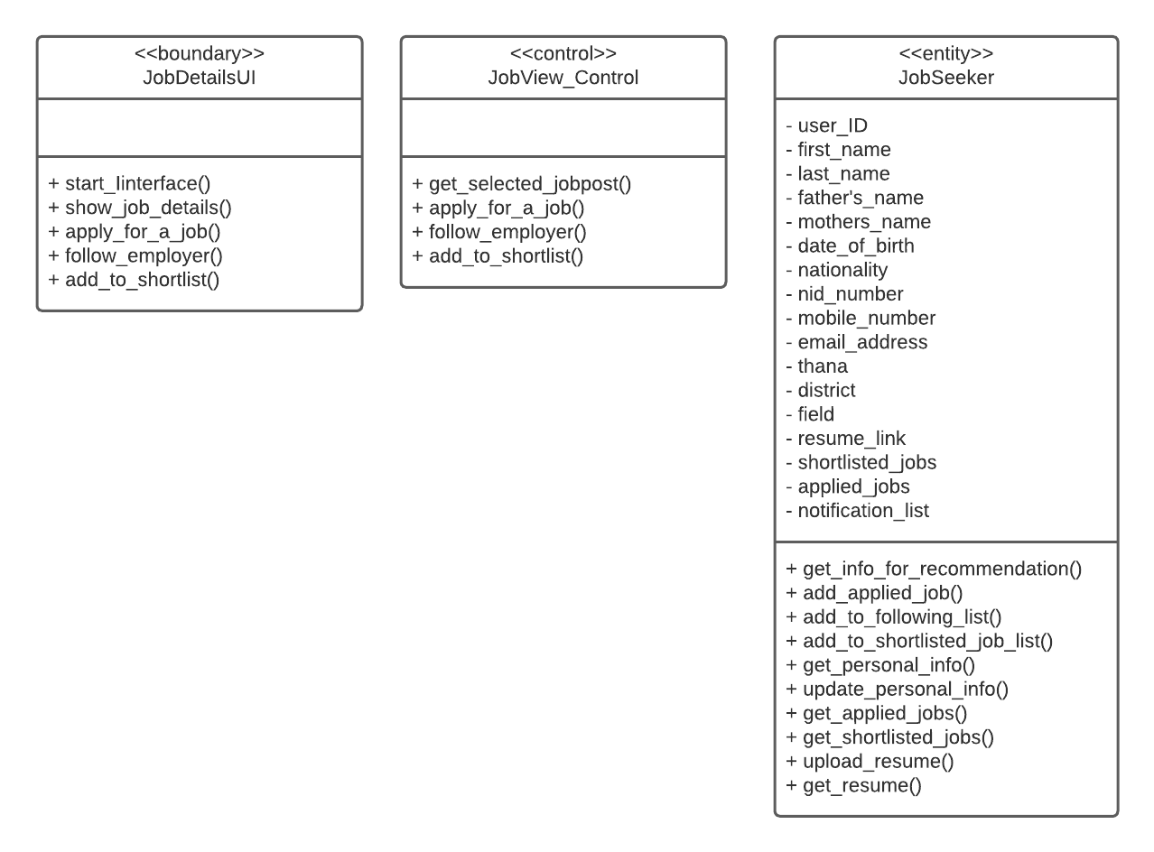
Shortlist jobs

Slide 11
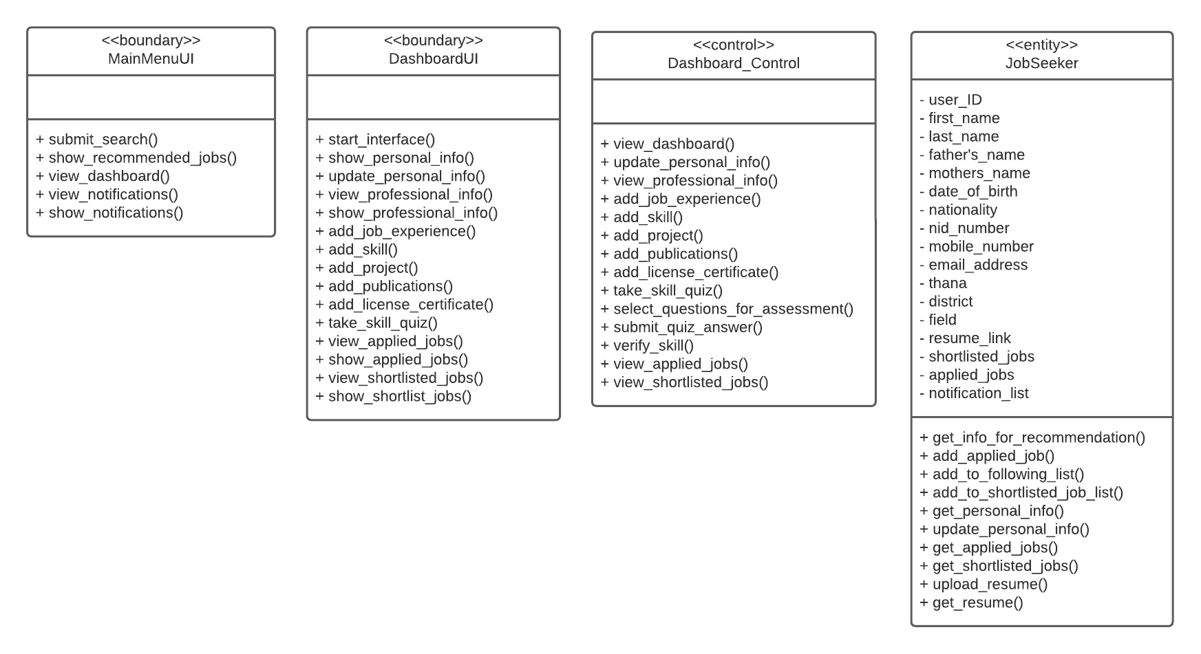
Dashboard - Personal Information

Slide 12
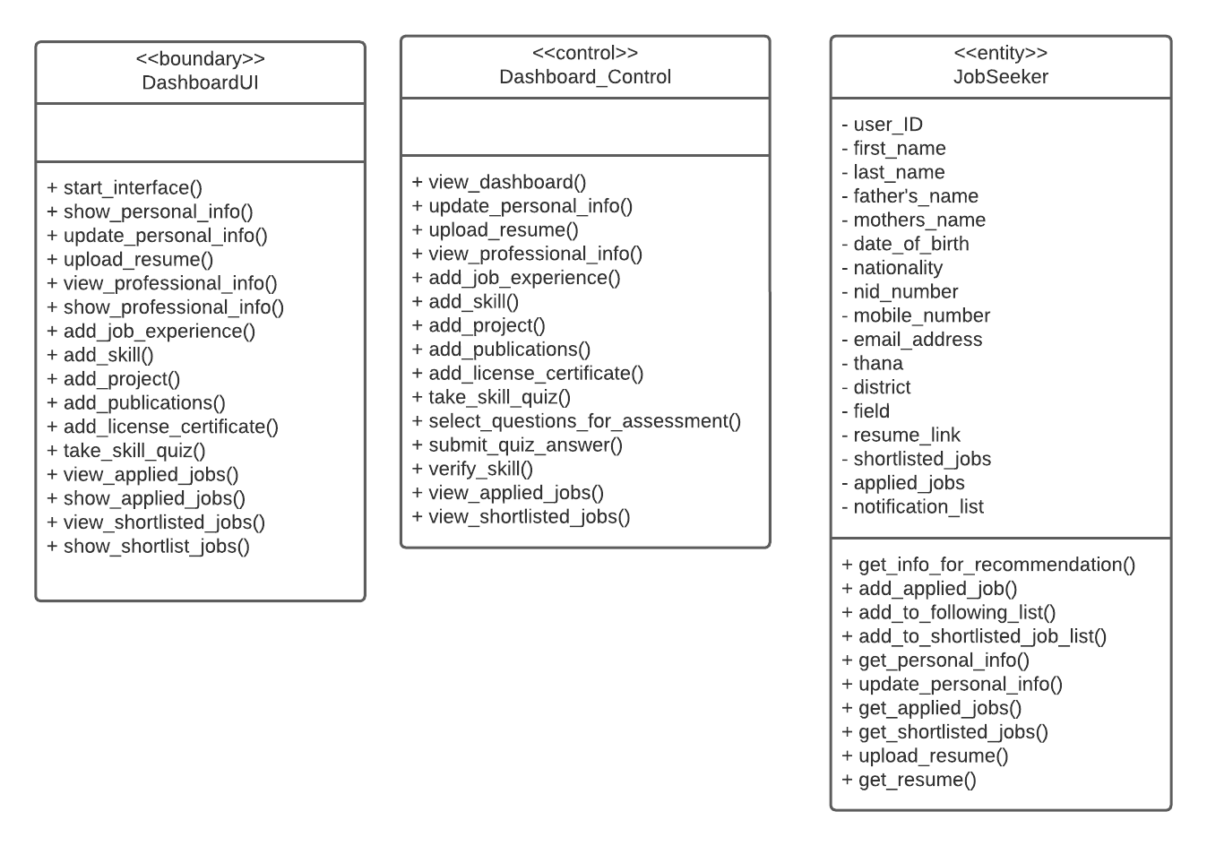
Dashboard - Upload Resume

Slide 13
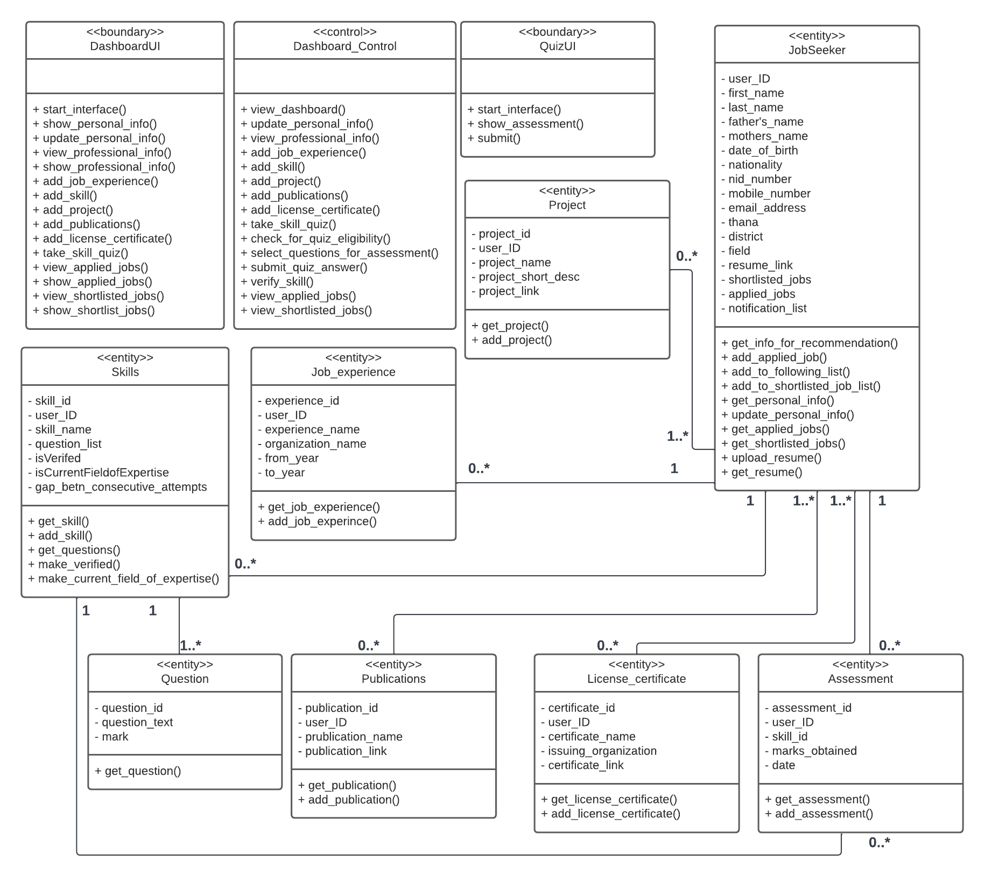
Dashboard - Professional Information

Slide 14
Dashboard - Professional Information

Slide 15
Dashboard - Professional Information

Slide 16
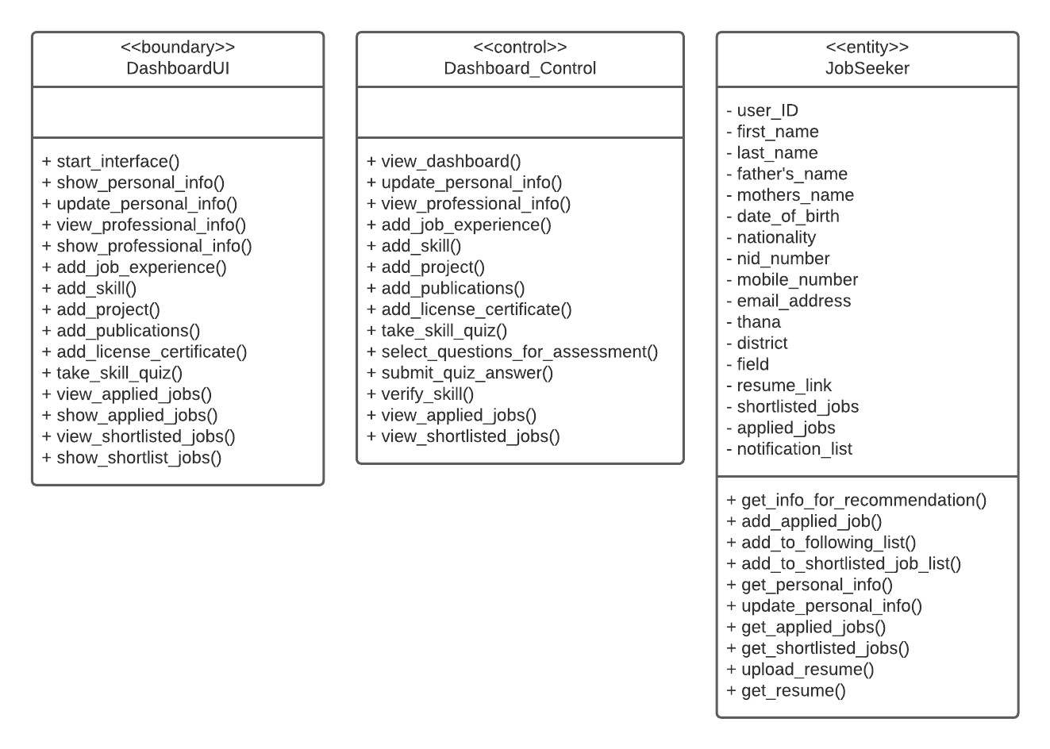
Dashboard - View Applied and Shortlisted Jobs

Slide 17
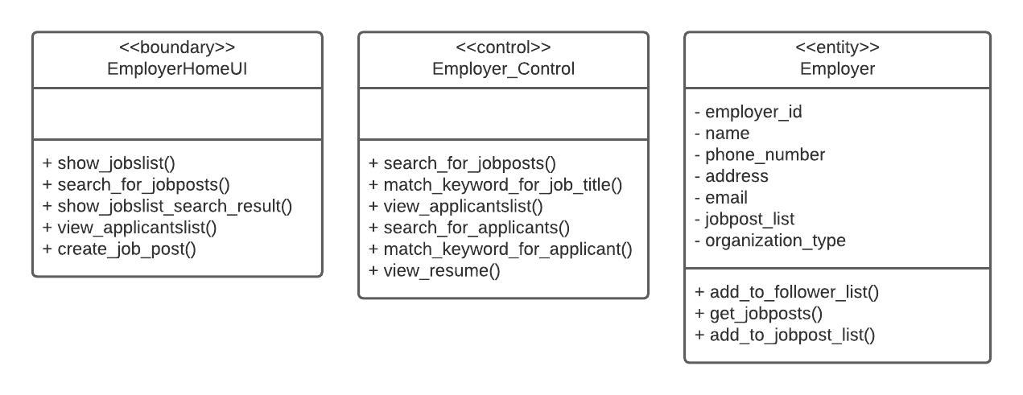
View Posted Jobs

Slide 18
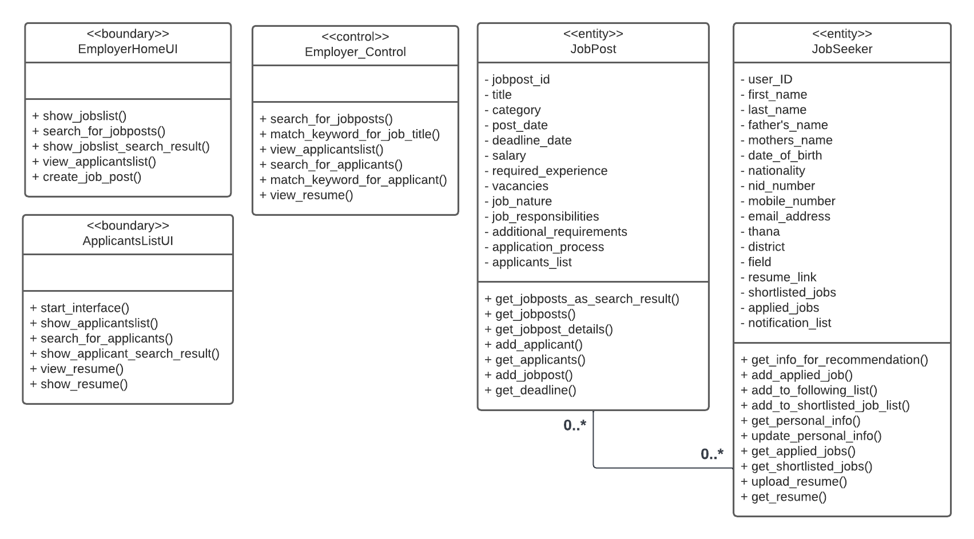
View Applicants

Slide 19
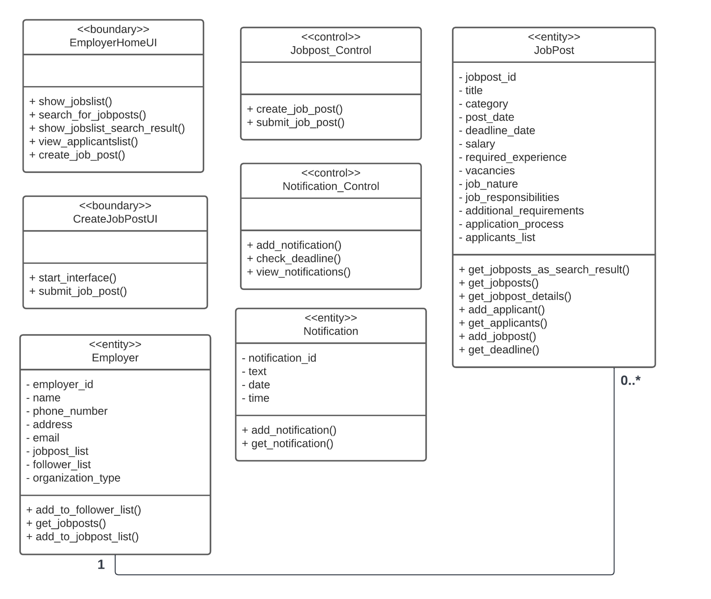
Post a Job

Slide 20
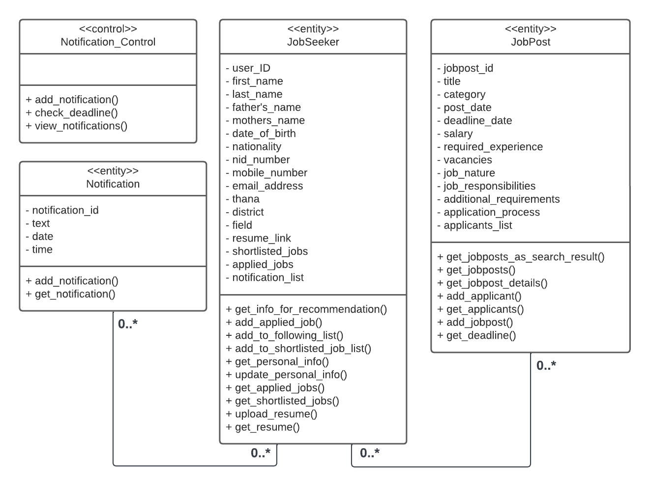
Generate Notification (Deadline Reminder)

Slide 21
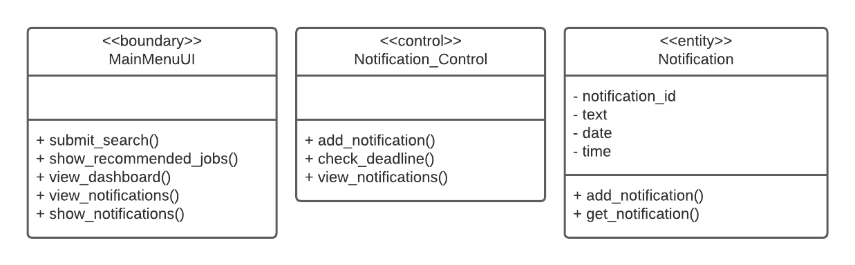
View Notifications

Slide 22
Full ERD

Slide 23
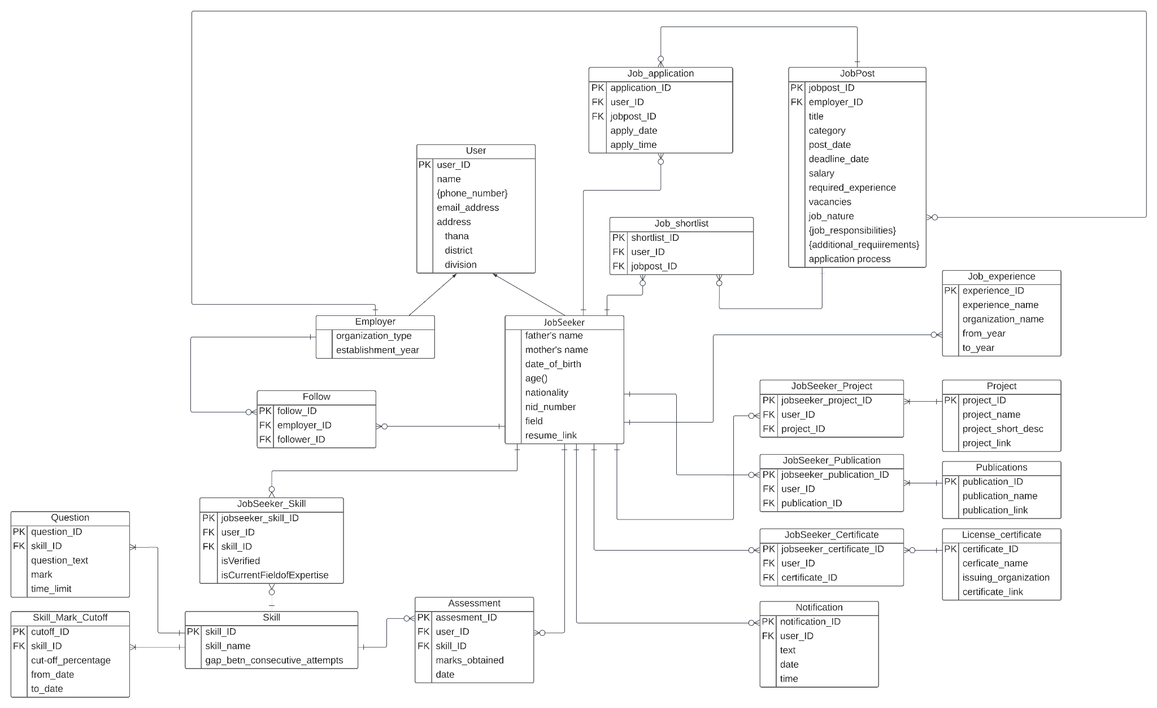

Slide 24
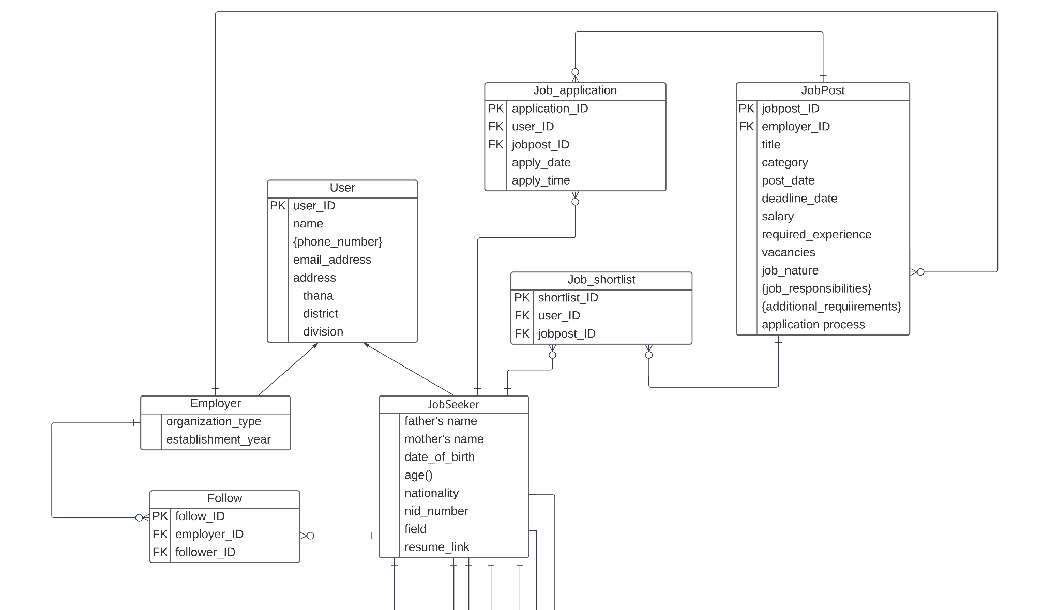
Jobposting, Apply, Follow and Shortlist

Slide 25
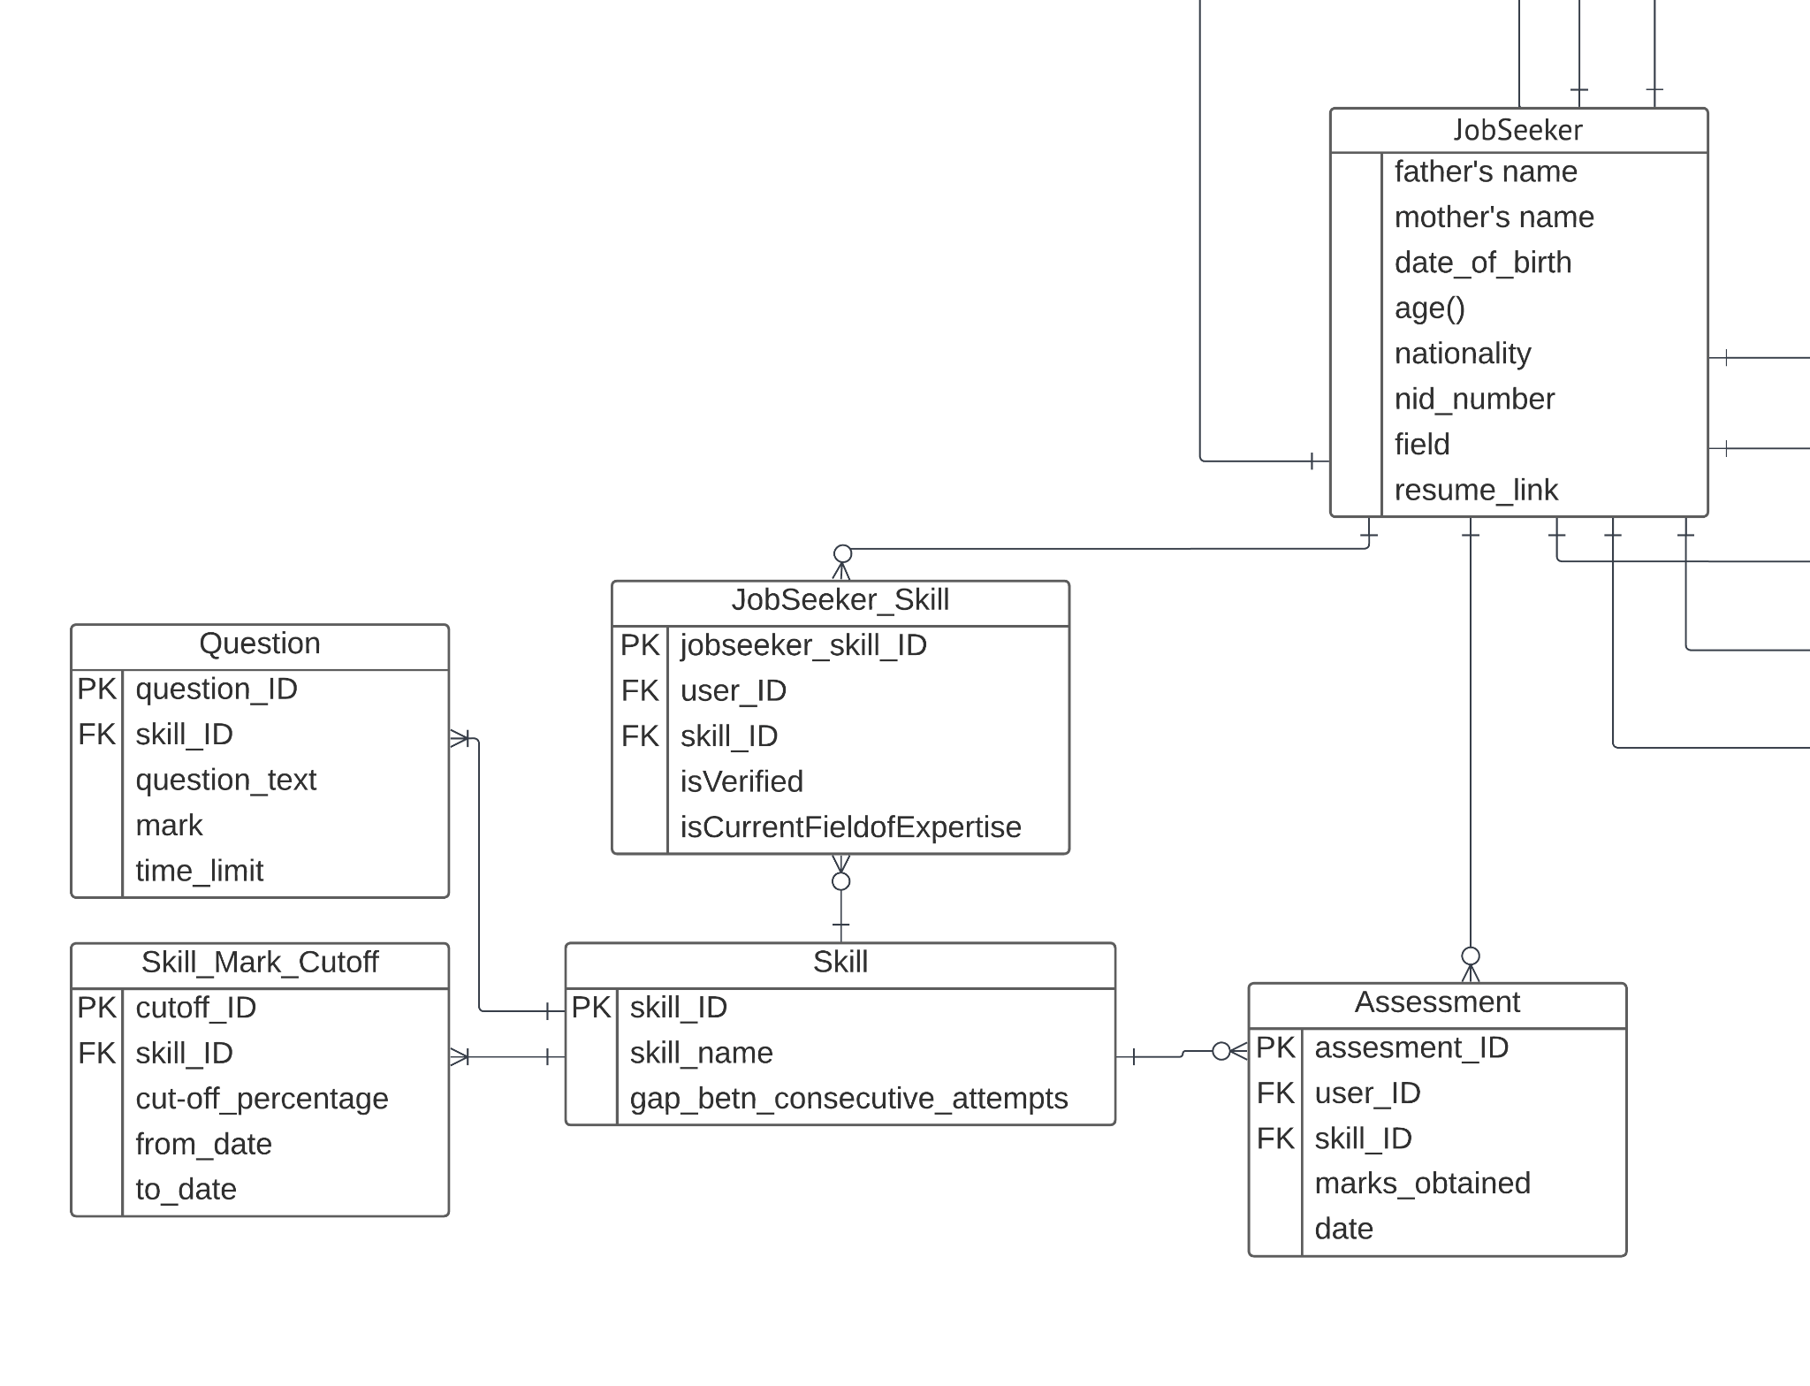
Skills and Assessment Quiz

Slide 26
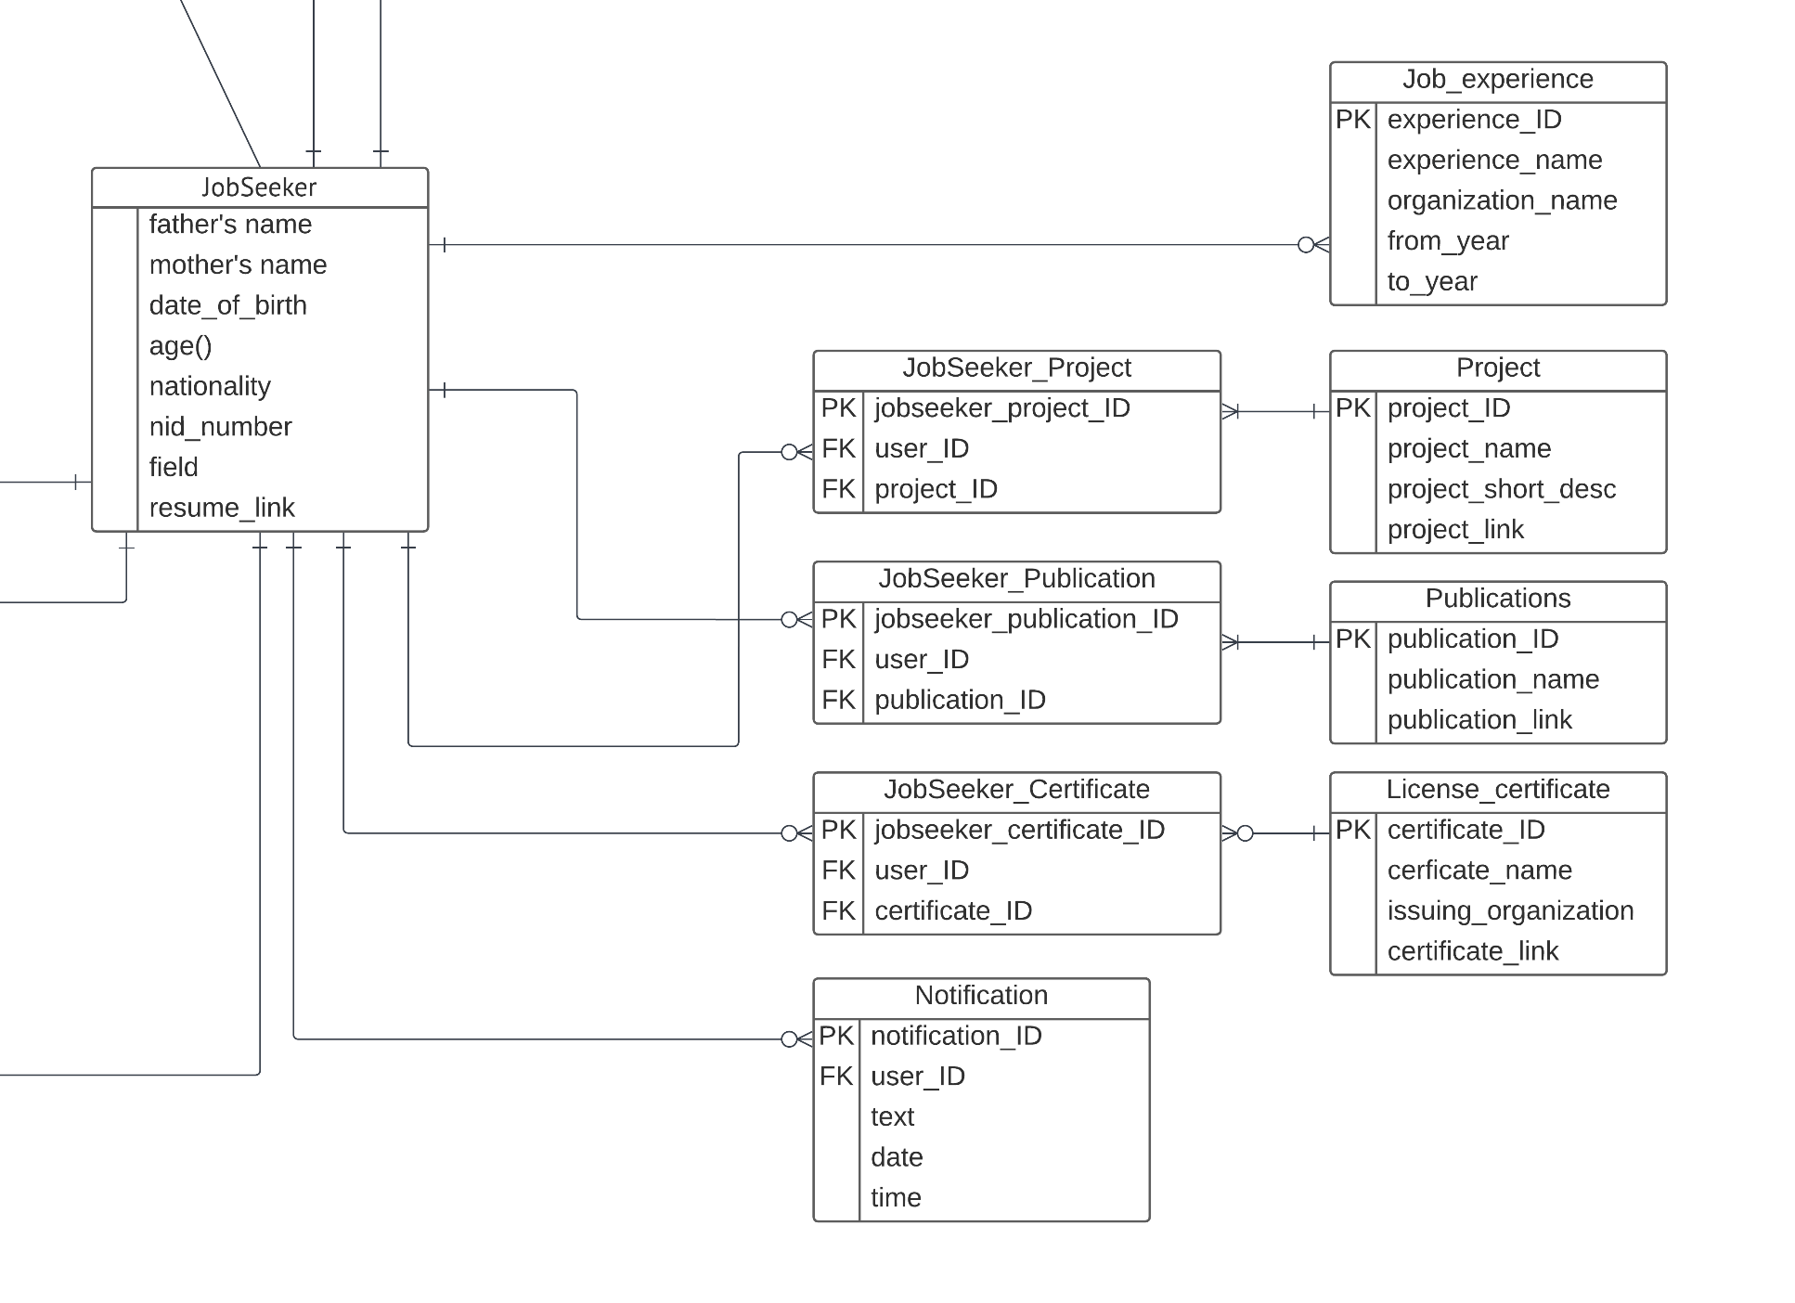
Other Professional Information and Notification

Slide 27
Thank You

